Slide 1

How does optimal photosynthetic acclimation affect future carbon and nutrient cycling?
Nick Smith¹, Trevor Keenan^{2,3}, Qing Zhu³, & Bill Riley³
¹Texas Tech University
²University of California Berkeley
³Lawrence Berkeley National Laboratory

Slide 2
Photosynthesis connects C and N cycles
nick.smith@ttu.edu; @nick_greg_smith
Walker et al. (2020)

Slide 3
Photosynthesis connects C and N cycles
nick.smith@ttu.edu; @nick_greg_smith
Walker et al. (2020)

Slide 4
Models simulate photosynthetic capacity from soil N
nick.smith@ttu.edu; @nick_greg_smith
+
+
Photosynthetic
capacity
Soil N
Leaf N

Slide 5
Elevated CO₂ reduces photosynthetic capacity
nick.smith@ttu.edu; @nick_greg_smith
mean: -15%
Smith and Keenan (2020)

Slide 6
This may be due to N limitation
nick.smith@ttu.edu; @nick_greg_smith
mean: -15%
Smith and Keenan (2020)

Slide 7
There is another explanation for this effect: photosynthetic optimality
nick.smith@ttu.edu; @nick_greg_smith
(P > 0.05)
Smith and Keenan (2020)

Slide 8
Biochemistry optimization: Coordination hypothesis
nick.smith@ttu.edu; @nick_greg_smith
Optimal setup = equal limitation by all factors

Slide 9
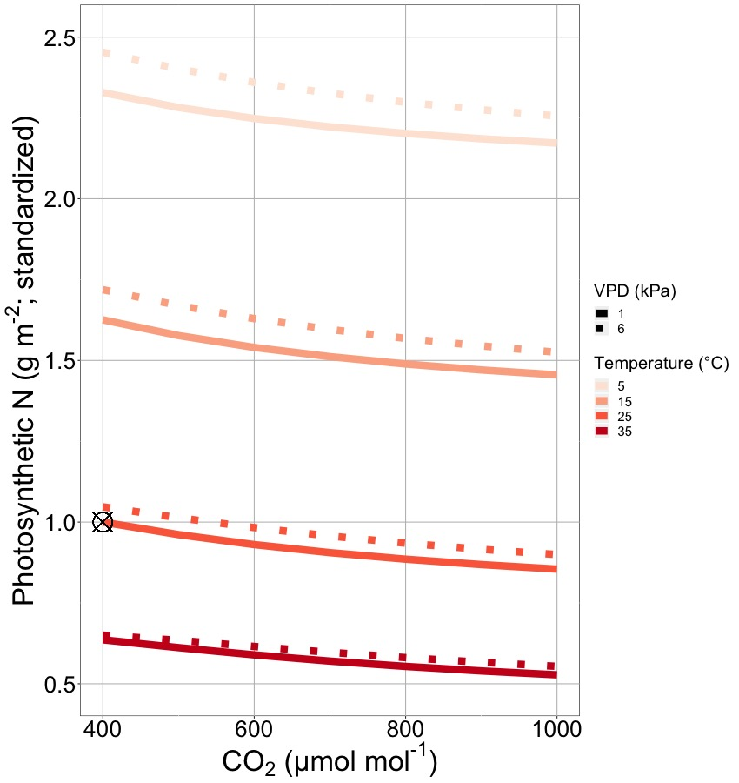
Optimally, demand for photosynthetic proteins will decrease with warming and elevated CO₂
nick.smith@ttu.edu; @nick_greg_smith
Reason 1: more CO₂ = less need for enzymes to maximize light use
Reason 2: warming increases enzymatic rate = less enzymes needed
Smith and Keenan (2020)

Slide 10
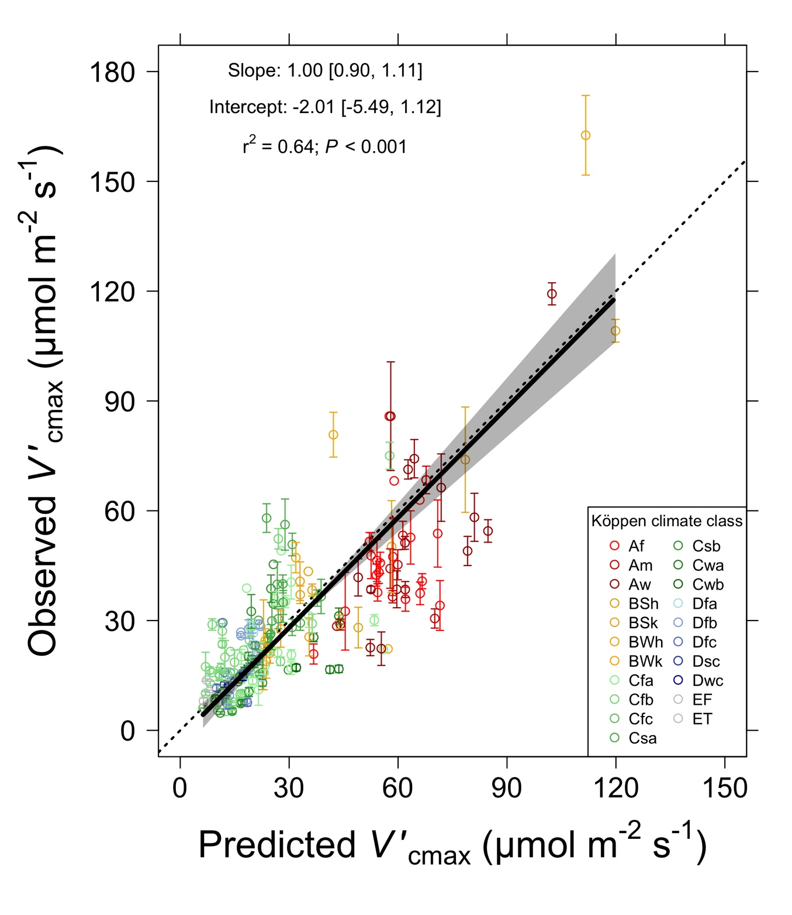
nick.smith@ttu.edu; @nick_greg_smith
Optimal V_{cmax} is similar to observed values
Smith et al. (2019)

Slide 11
Current photosynthesis scheme
nick.smith@ttu.edu; @nick_greg_smith
+
+
Photosynthetic
capacity
Soil N
Leaf N

Slide 12
New photosynthesis scheme
nick.smith@ttu.edu; @nick_greg_smith
Climate Change
-
+
Photosynthetic
capacity
Leaf N

Slide 13

Let’s run a model out into the future!
nick.smith@ttu.edu; @nick_greg_smith
Qing Zhu (LBNL)

Slide 14
ELM fixed phenology runs
Two canopy model with fixed LAI
No nitrogen model
Optimal photosynthetic coordination determines leaf nutrient demand
Leaf nitrogen back calculated from photosynthesis
Simulations to 2100 (RCP 8.5)

Slide 15
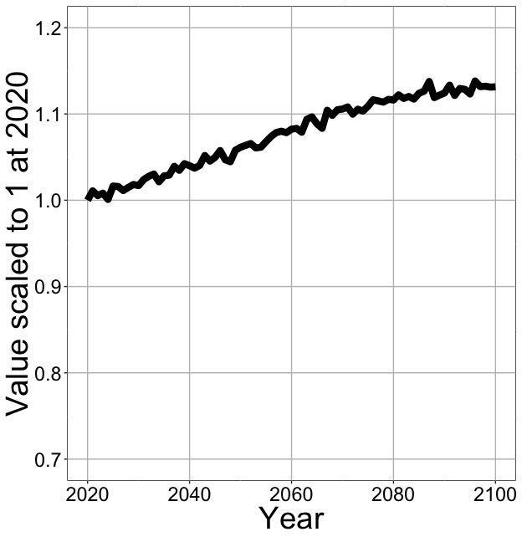
Optimal photosynthesis increases in future
nick.smith@ttu.edu; @nick_greg_smith
Net Photosynthesis
Smith et al. (in prep)

Slide 16
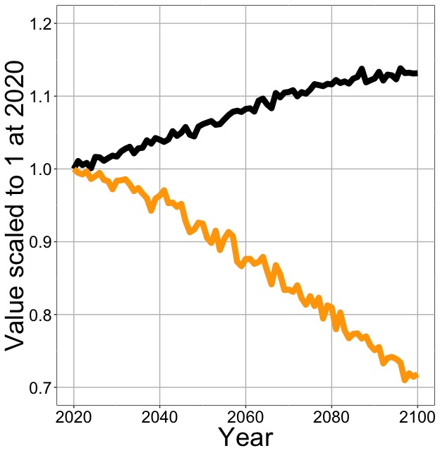
Optimal photosynthesis increases in future (at lower nutrient use)
nick.smith@ttu.edu; @nick_greg_smith
Net Photosynthesis
Leaf Nitrogen
Smith et al. (in prep)

Slide 17
Optimal photosynthesis increases in future (at lower nutrient use)
nick.smith@ttu.edu; @nick_greg_smith
Base ELM shows <5% change in leaf N
Net Photosynthesis
Leaf Nitrogen
Smith et al. (in prep)

Slide 18
What does this mean for the ecosystem?

Slide 19
New scheme might increase soil N
nick.smith@ttu.edu; @nick_greg_smith
Soil
N uptake
Soil N
Climate Change
-
-
+
+
Photosynthetic
capacity
Leaf N

Slide 20
Let’s run a model out into the future!
nick.smith@ttu.edu; @nick_greg_smith
Qing Zhu (LBNL)

Slide 21
ELM biogeochemistry runs
Optimal photosynthetic coordination determines leaf nutrient demand
Using available nutrients, plants try to meet this demand
If demand cannot be met, leaves are purged
If demand is met, any excess nutrients are used to build new tissue using ELM’s dynamic allocation scheme
Allocation, but not photosynthetic nutrient demand, varies by PFT
Simulations done with and without calculated nutrient savings

Slide 22
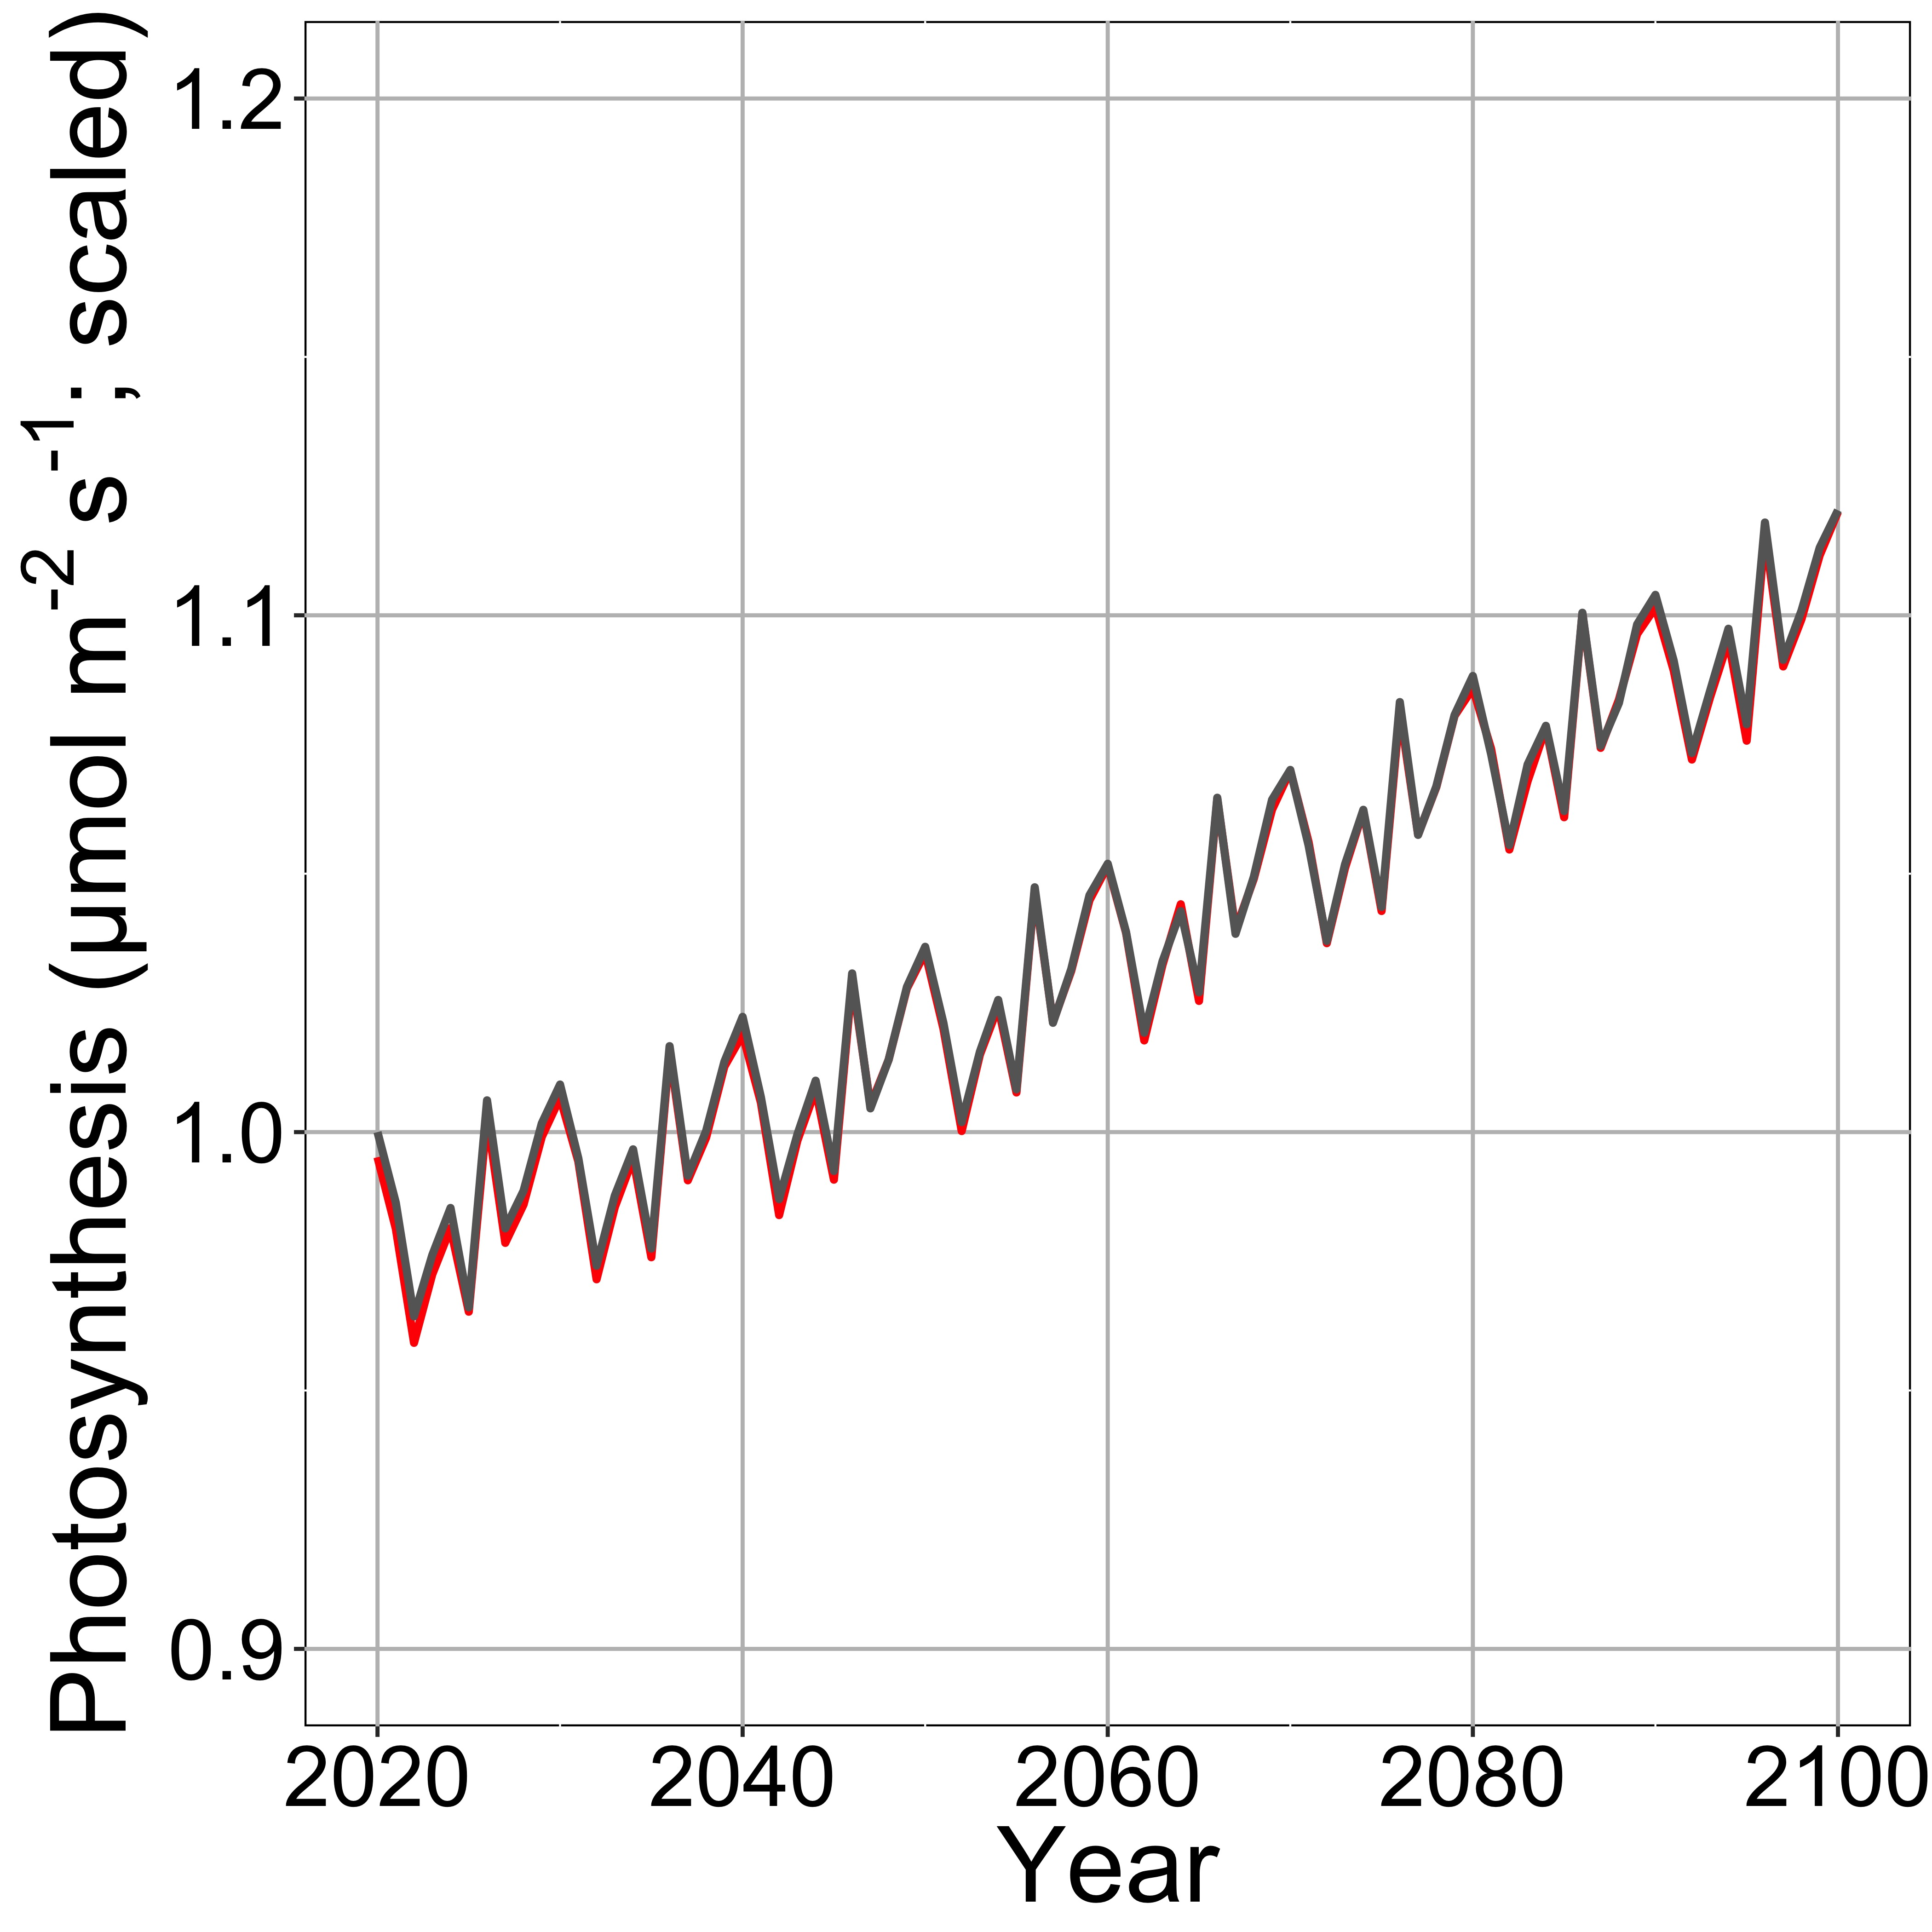
Nutrient savings does not impact leaf photosynthesis
Optimal photosynthesis with N savings
Optimal photosynthesis without N savings

Slide 23
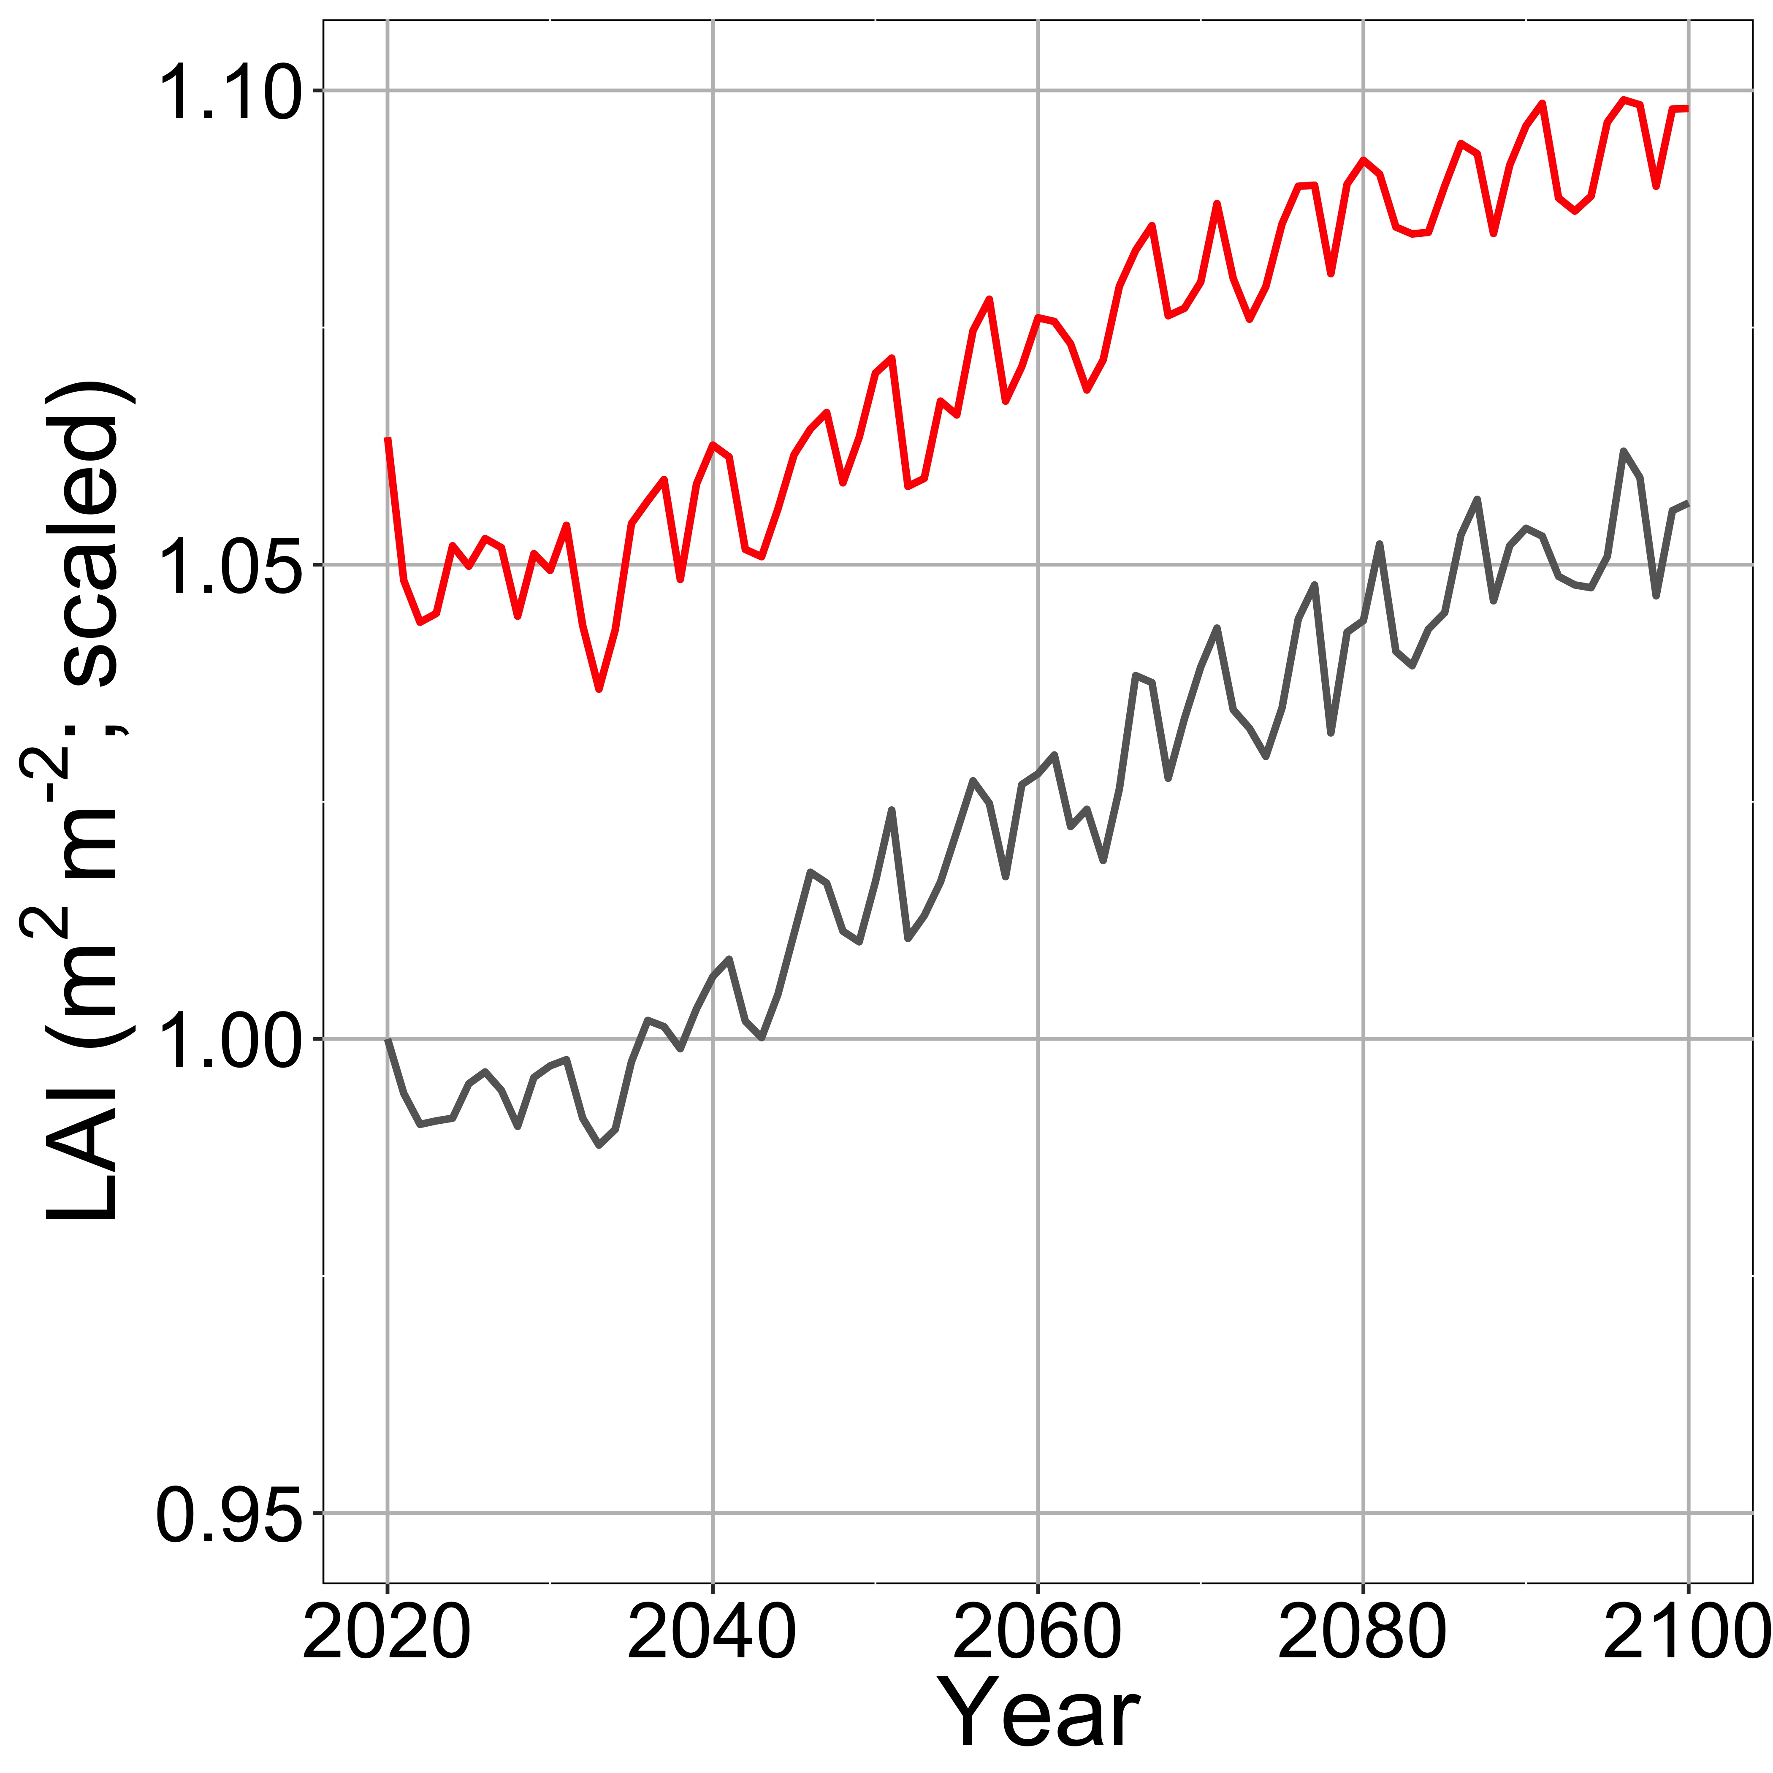
Nutrient savings is used to build new tissues
Optimal photosynthesis with N savings
Optimal photosynthesis without N savings

Slide 24
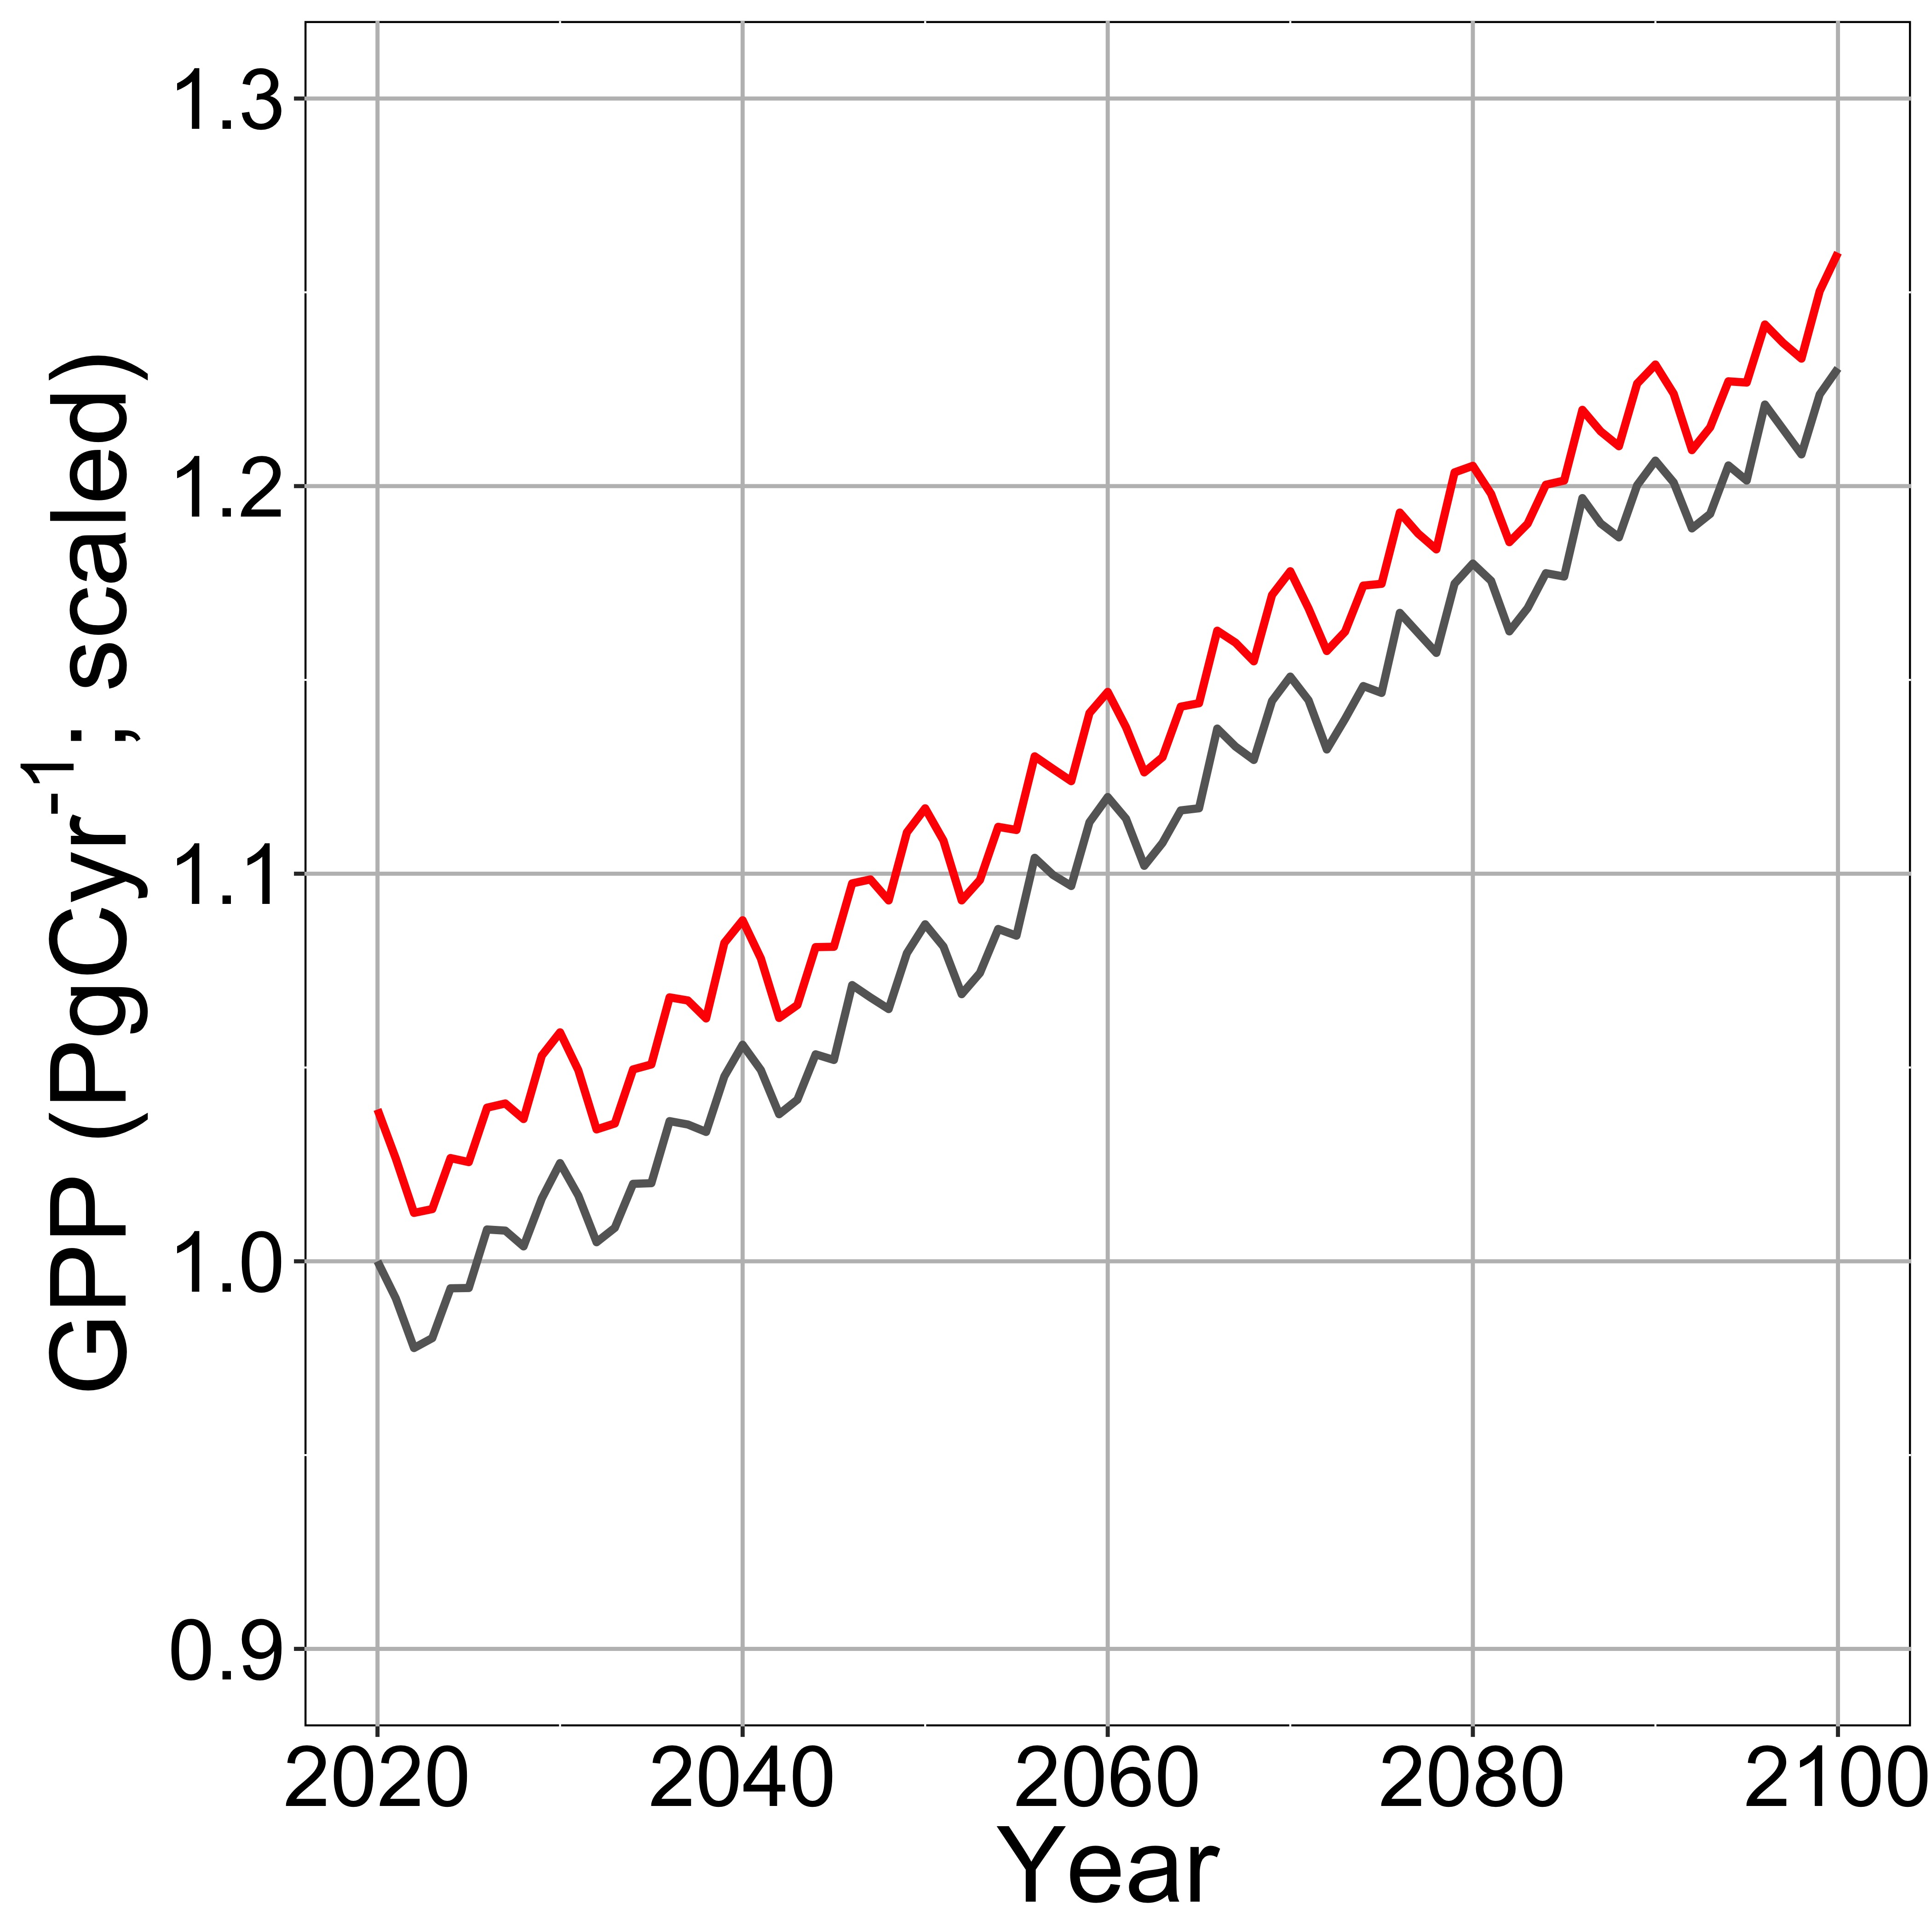
This increases 2100 GPP by 2.5%
Optimal photosynthesis with N savings
Optimal photosynthesis without N savings

Slide 25
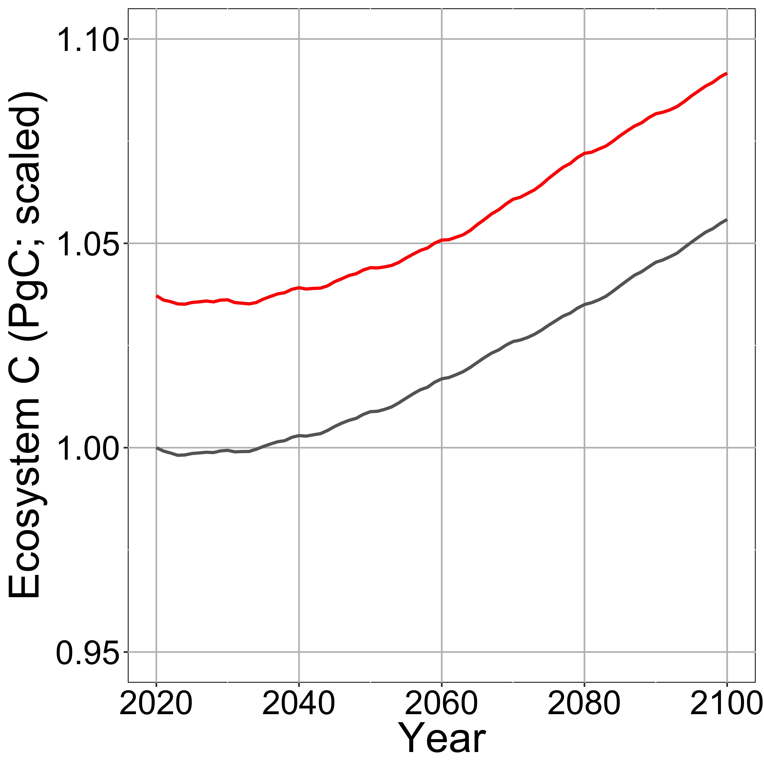
This increases 2100 ecosystem C by 3.4%
Optimal photosynthesis with N savings
Optimal photosynthesis without N savings

Slide 26
What does this all mean?

Slide 27
Future progressive nutrient limitation may be overestimated
nick.smith@ttu.edu; @nick_greg_smith
“No limitation” simulation
“Nutrient limitation” simulations
Weider et al. (2015)

Slide 28
Conclusions
Photosynthetic N demand is reduced under future elevated CO₂ and temperature
Least cost optimality theory can predict this
The theory can (and should) be incorporated into ESMs
No added parameters
Progressive nitrogen limitation will not be as strong as current models predict

Slide 29

nick.smith@ttu.edu; @nick_greg_smith
Presentation available at:
www.github.com/SmithEcophysLab/seminar/agu_2020
Thanks!

